Slide 1
Caffeine
By: Morgan

Slide 2
Table of contents
What is caffeine
What foods/drinks have caffeine
What effects does caffeine have on people
What happens when you have to much caffeine

Slide 3
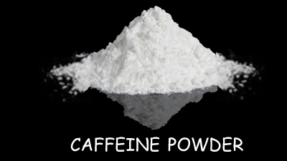
What is caffeine
A compound that is found especially in tea and coffee plants

Slide 4
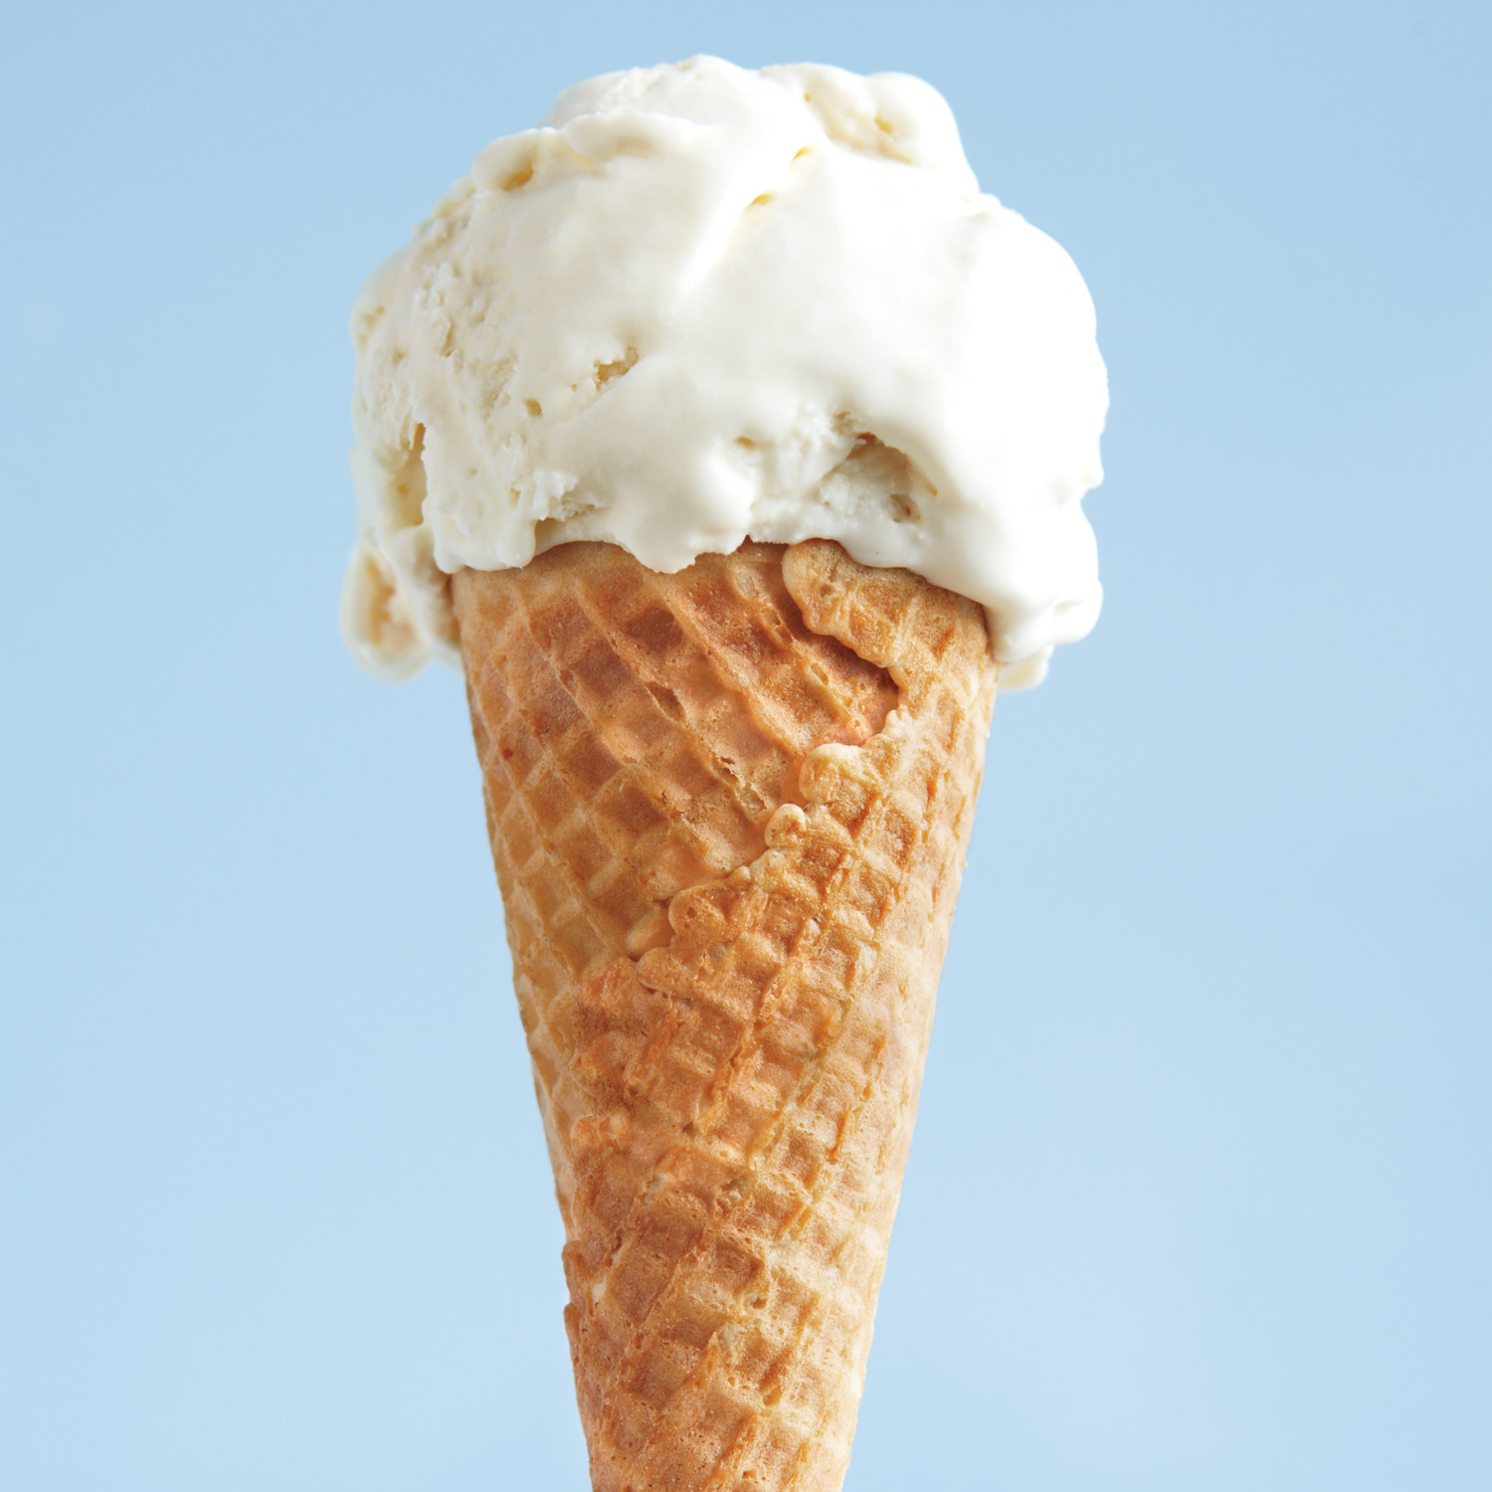
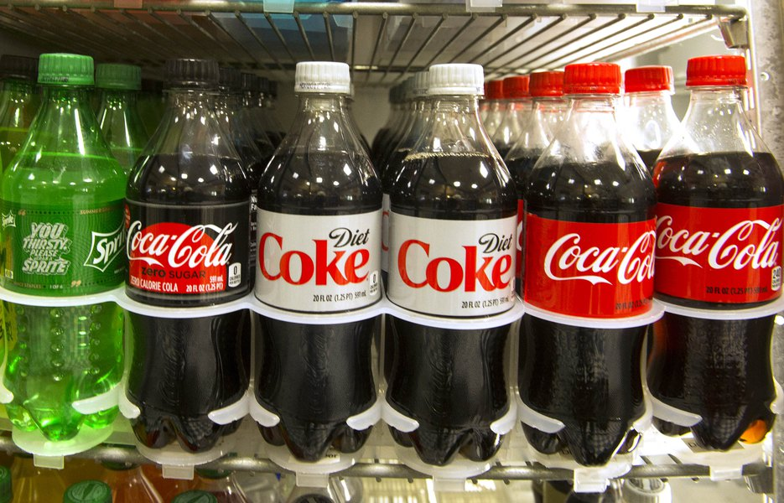
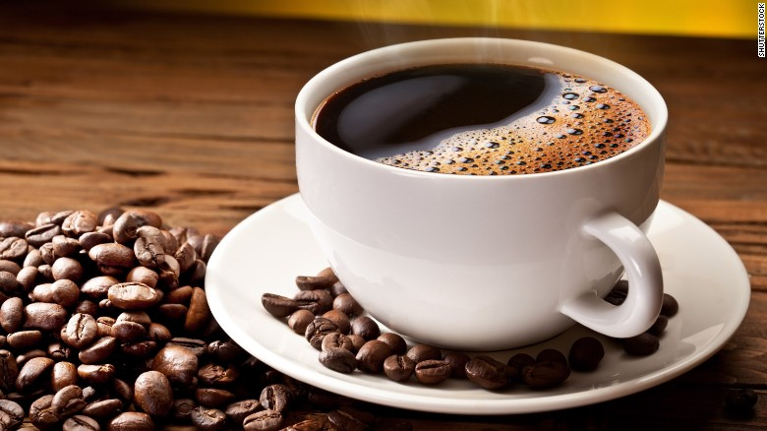
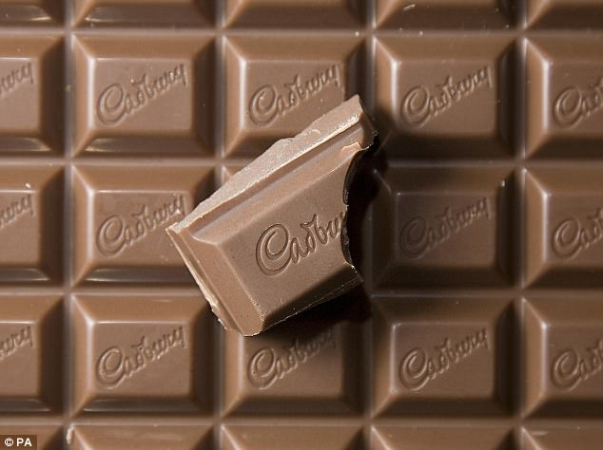
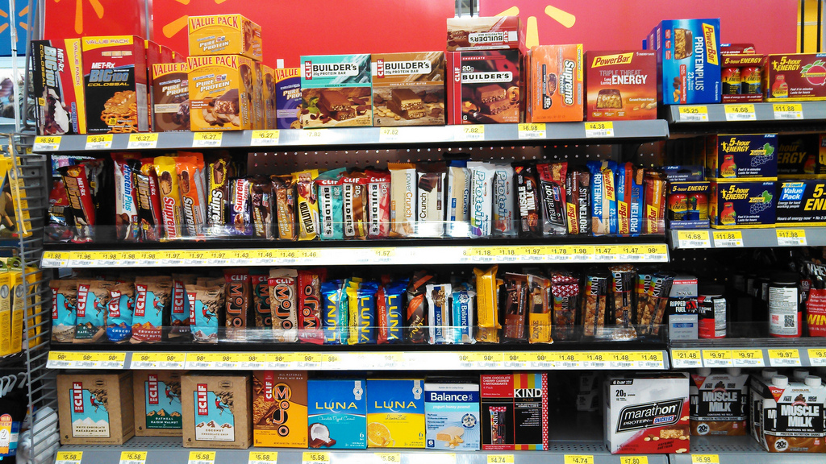
What foods/drinks have caffeine
soft drinks
Chocolates
Ice cream
Protein bars
Coffee

Slide 5
What effects does caffeine have on people
Caffeine acts as a nervous system stimulant. When it reaches your brain, the most noticeable effect is alertness. You'll feel more awake and less tired.

Slide 6
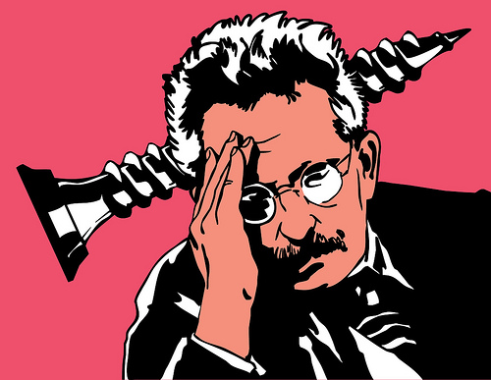
What happens when you have to much caffeine
When you have to much caffeine you will start feeling nervous and get a headache.

