Slide 1
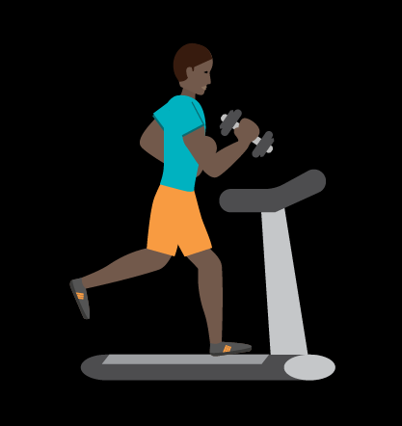
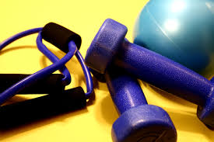
Exercise
By: Austin

Slide 2
Table of Contents
Why It’s Good
Why you Exercise
Different Types Of Exercise

Slide 3
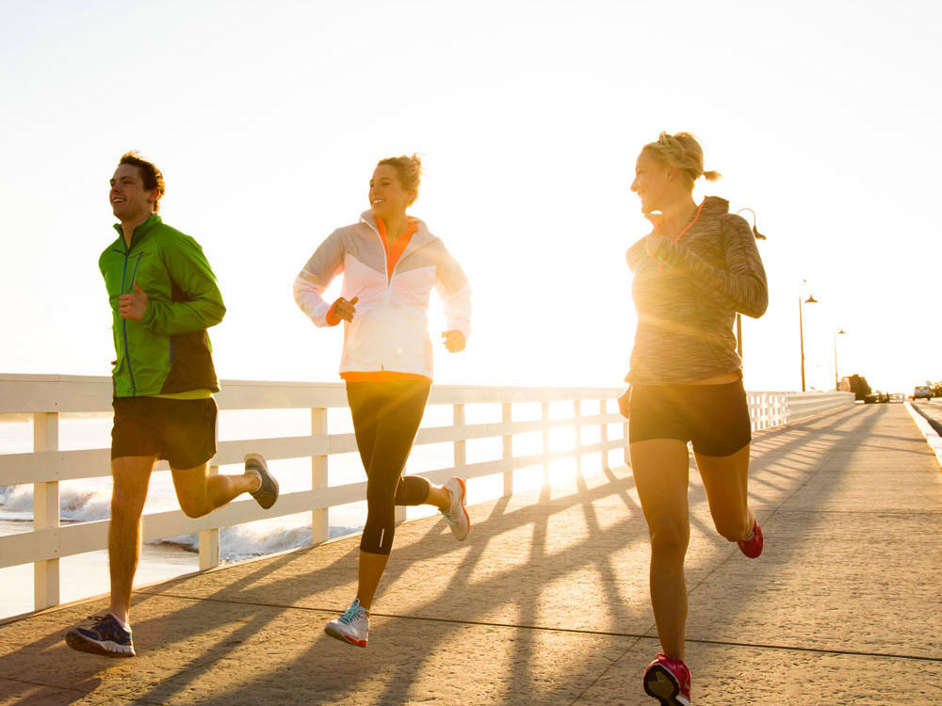
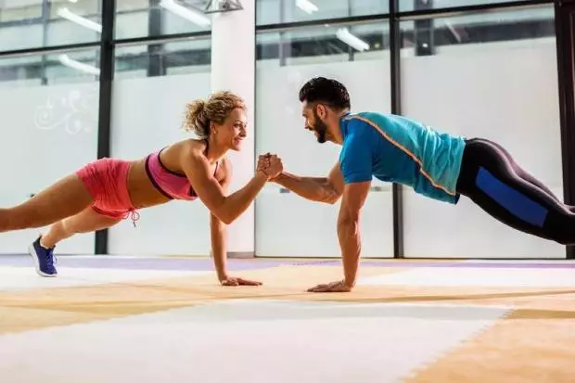
Why it’s Good.
It is very good for you and your body because, physical activity or exercise can improve your health and reduce the risk of developing several diseases, physical activity and exercise can have immediate and long term health benefits. Most importantly, regular activity can improve your quality of life.

Slide 4
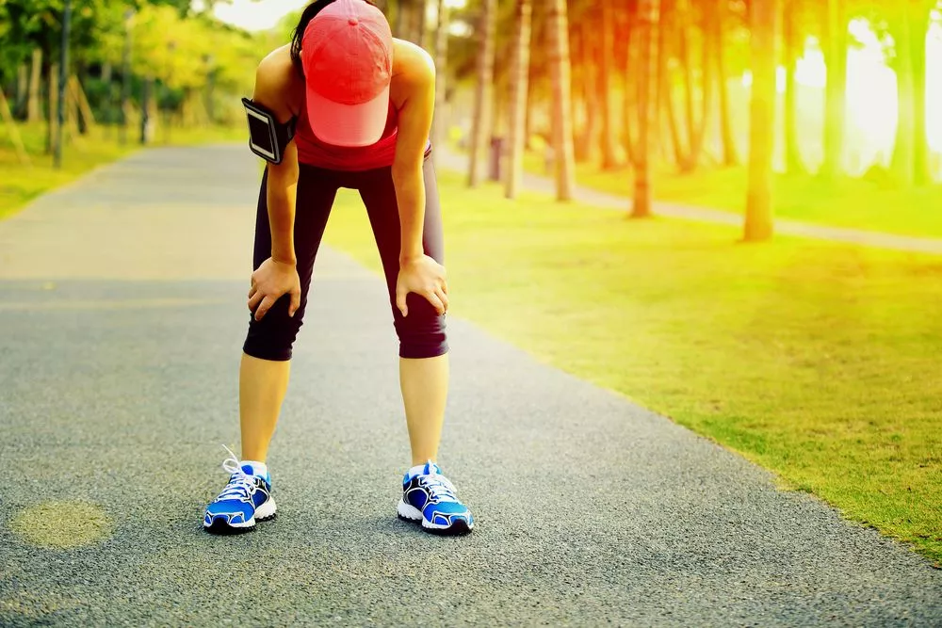
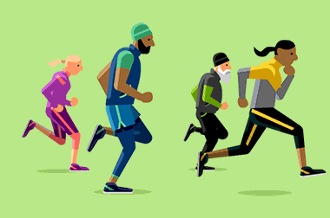
Why you Should Exercise.
You should exercise for at least 1 hour everday to stay fit. Exercise can help you look better and exercise can help keep your body at a healthy weight.

Slide 5
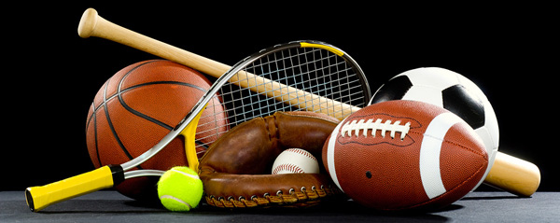
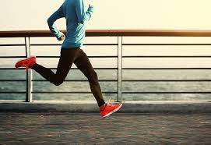
Different Types of Exercise
There are many types of exercise such as, Swimming, Running, weightlifting, Team sports, Wrestling, Jogging and much, much more.

Slide 6
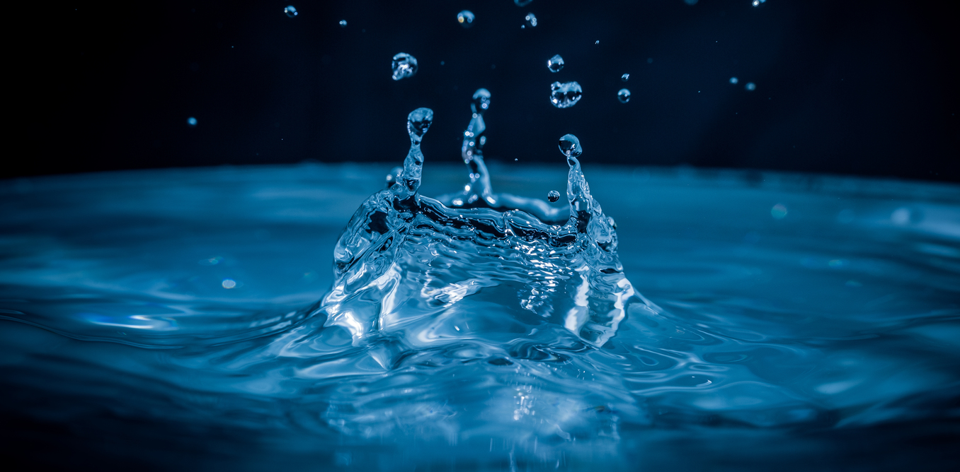
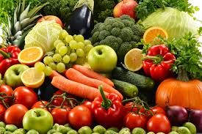
Foods to Eat/Drink While Exercising
You probably should not eat while exercising cause it will make you stomach hurt but if you have to eat fruits and vegetables and you should drink lots of water while exercising.

