Slide 2
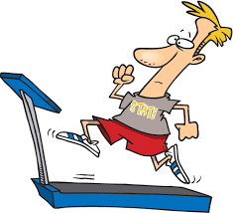
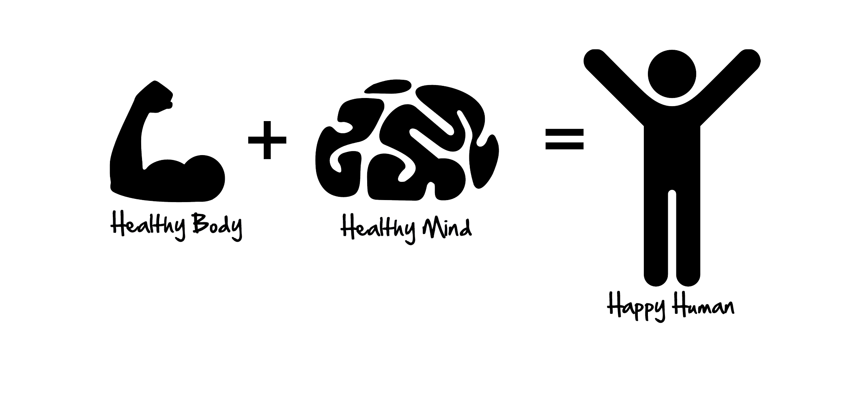
Healthy food guide for athletics
By: Abraham

Slide 3
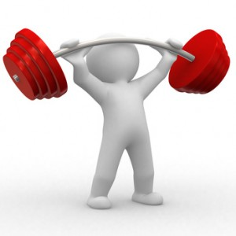
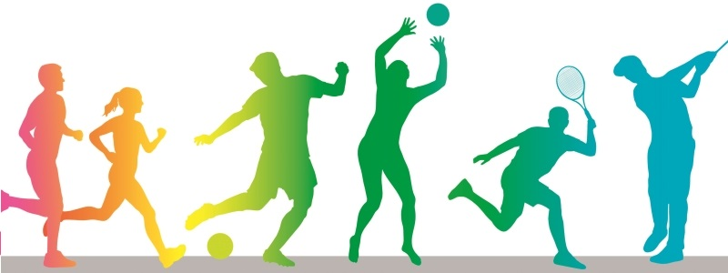
Introduction
Hello I will be showing you how to take care of your body as an athlete, for example the food guide, how long you need to exercise, why you need to exercise and so on etc….

Slide 4
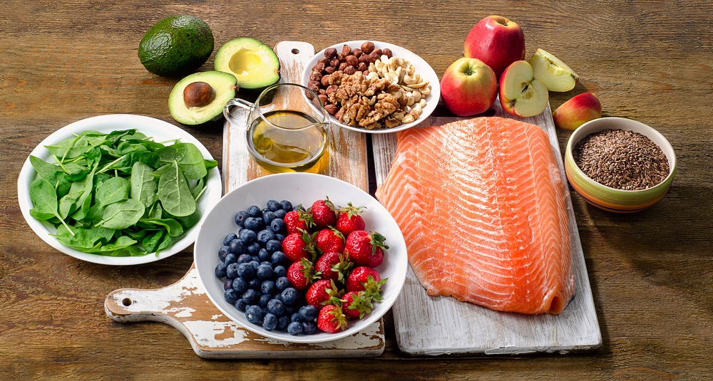
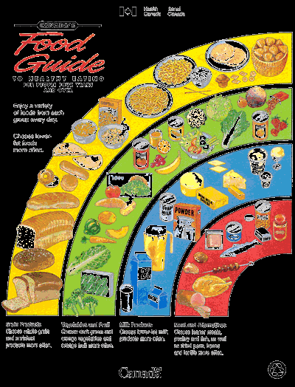
!
Nutrition for athletics performance
Choosing the right type, amount, and timing of intake of foods, fluids and supplements can help active children and adults and competitive athlete perform their best.

Slide 5
Healthy food guide for athletics
Kids who eat healthy, well-balanced meals and snacks will get the nutrients needed to perform well in sports. The MyPlate food guide can provide guidance on what kinds of foods and drinks to include in your child's meals and snacks. The child athlete, however, will have higher energy and fluid requirements for children.

Slide 6
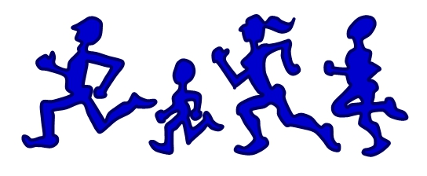
How long should athletes exercise
For a child they should be practicing 2-3 times a week for 1 hour 30 minutes. For an adult athletes they should be practicing for the whole week for 4-5 hours.

Slide 7
conclusion
Thanks for watching and I hope you learn a bit about the food guide .

