Slide 1
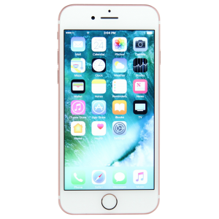
How Does Electronics Effect Sleep
By: dom

Slide 2
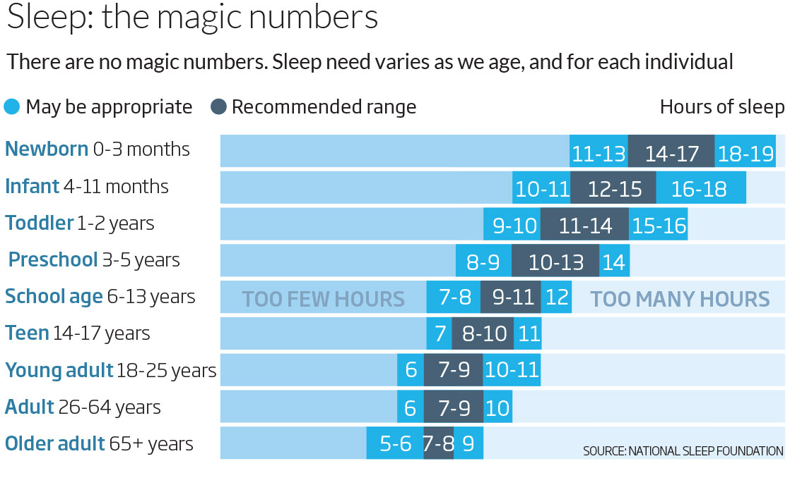
How long should you sleep

Slide 3
Why do electronics effect sleep
Using TV’s , tablets, smartphones, laptops, or other electronics before bed delays your body's internal clock ( a.k.a your circadian rhythm), suppresses the release of the sleep-inducing hormone melatonin, and makes it more difficult to fall asleep.

Slide 4
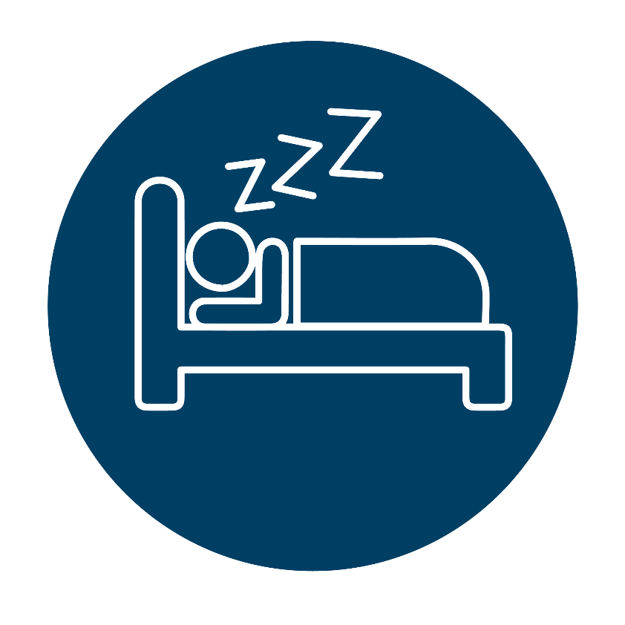
conclusion
You should get the right amount of sleep and instead read a book before bed.

Slide 5
References
https://sleepfoundation.org/sleep-topics/why-electronics-may-stimulate-you-bed

