Slide 1
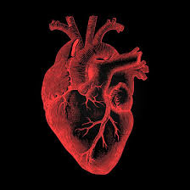
The Heart
By:Abraham

Slide 2
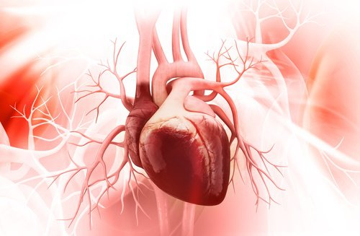
Introduction
These are the things that we will be talking about the heart.
Why we need a heart
What is the purpose of a heart
Why does our heart beat

Slide 3
Why you need a heart
Well, technically speaking, your body can still be alive without a brain. On the other hand, it's pretty difficult for your body to be alive without a heart.

Slide 4
What is the purpose of a heart
The human heart is an organ that pumps blood throughout the body via the circulatory system, supplying oxygen and nutrients to the tissues and removing carbon dioxide and other wastes.

Slide 5
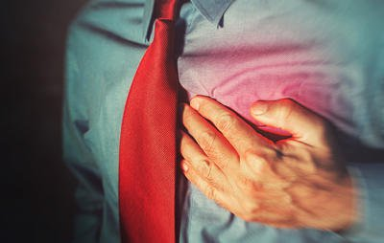
Why does the heart beat
The blood provides your body with the oxygen and nutrients it needs. It also carries away waste. Your heart is sort of like a pump, or two pumps in one. The right side of your heart receives blood from the body and pumps it to the lungs

Slide 6
The end
By Abraham

